Slide 1


Bike Sharing System EDA
Fajar Setiawan

Slide 2
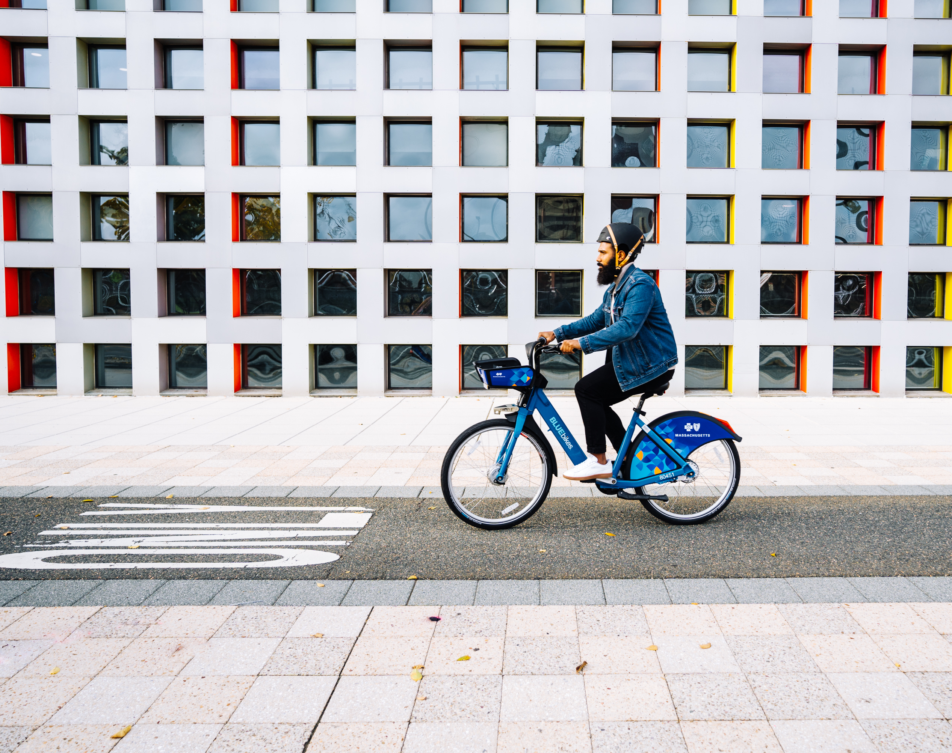
Content
Background
Goals
Analysis & Insight
Conclusion & Suggestion

Slide 3
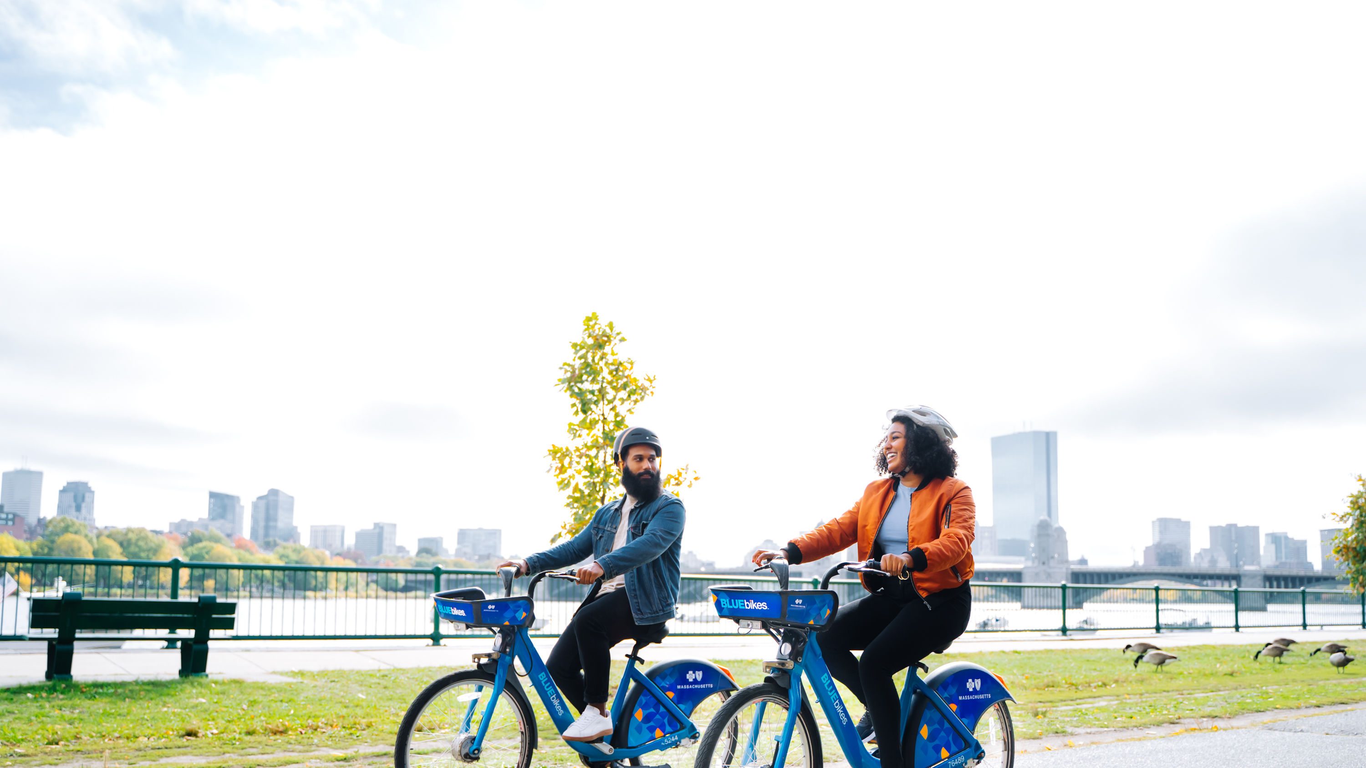
Background

Slide 4

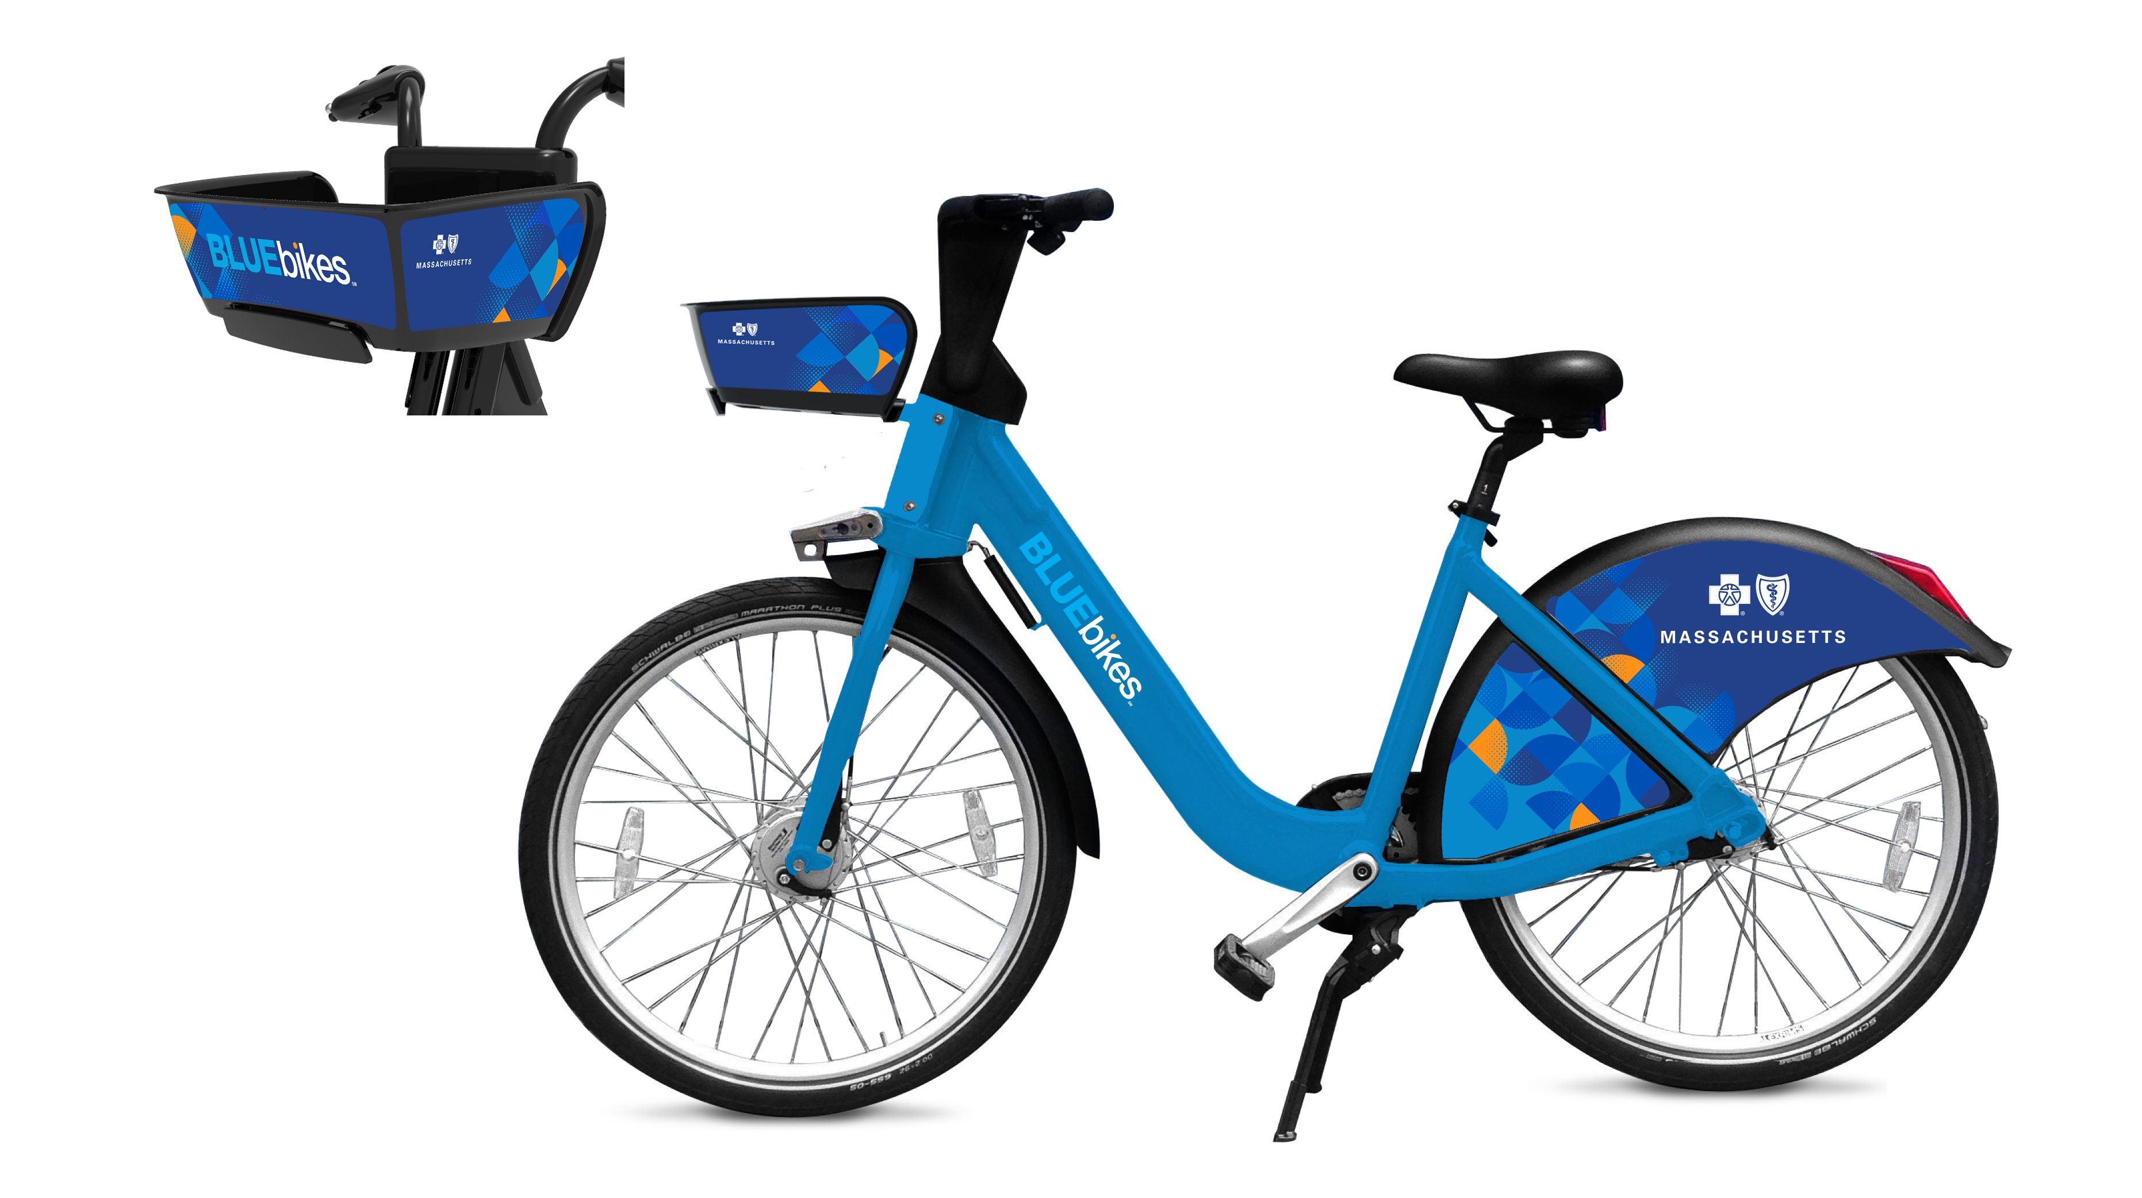
Background
BlueBike is a bicycle sharing system in the Boston metropolitan area that owned by the municipalities of Boston, Cambridge, Everett, and Somerville
The data provided is BlueBike activity in 2019
tripduration
distance(km)
starttime
stoptime
start station name
end station name
Bikeid
usertype
birth year
gender
month
hour
date
nameday
weekday/end
age

Slide 5
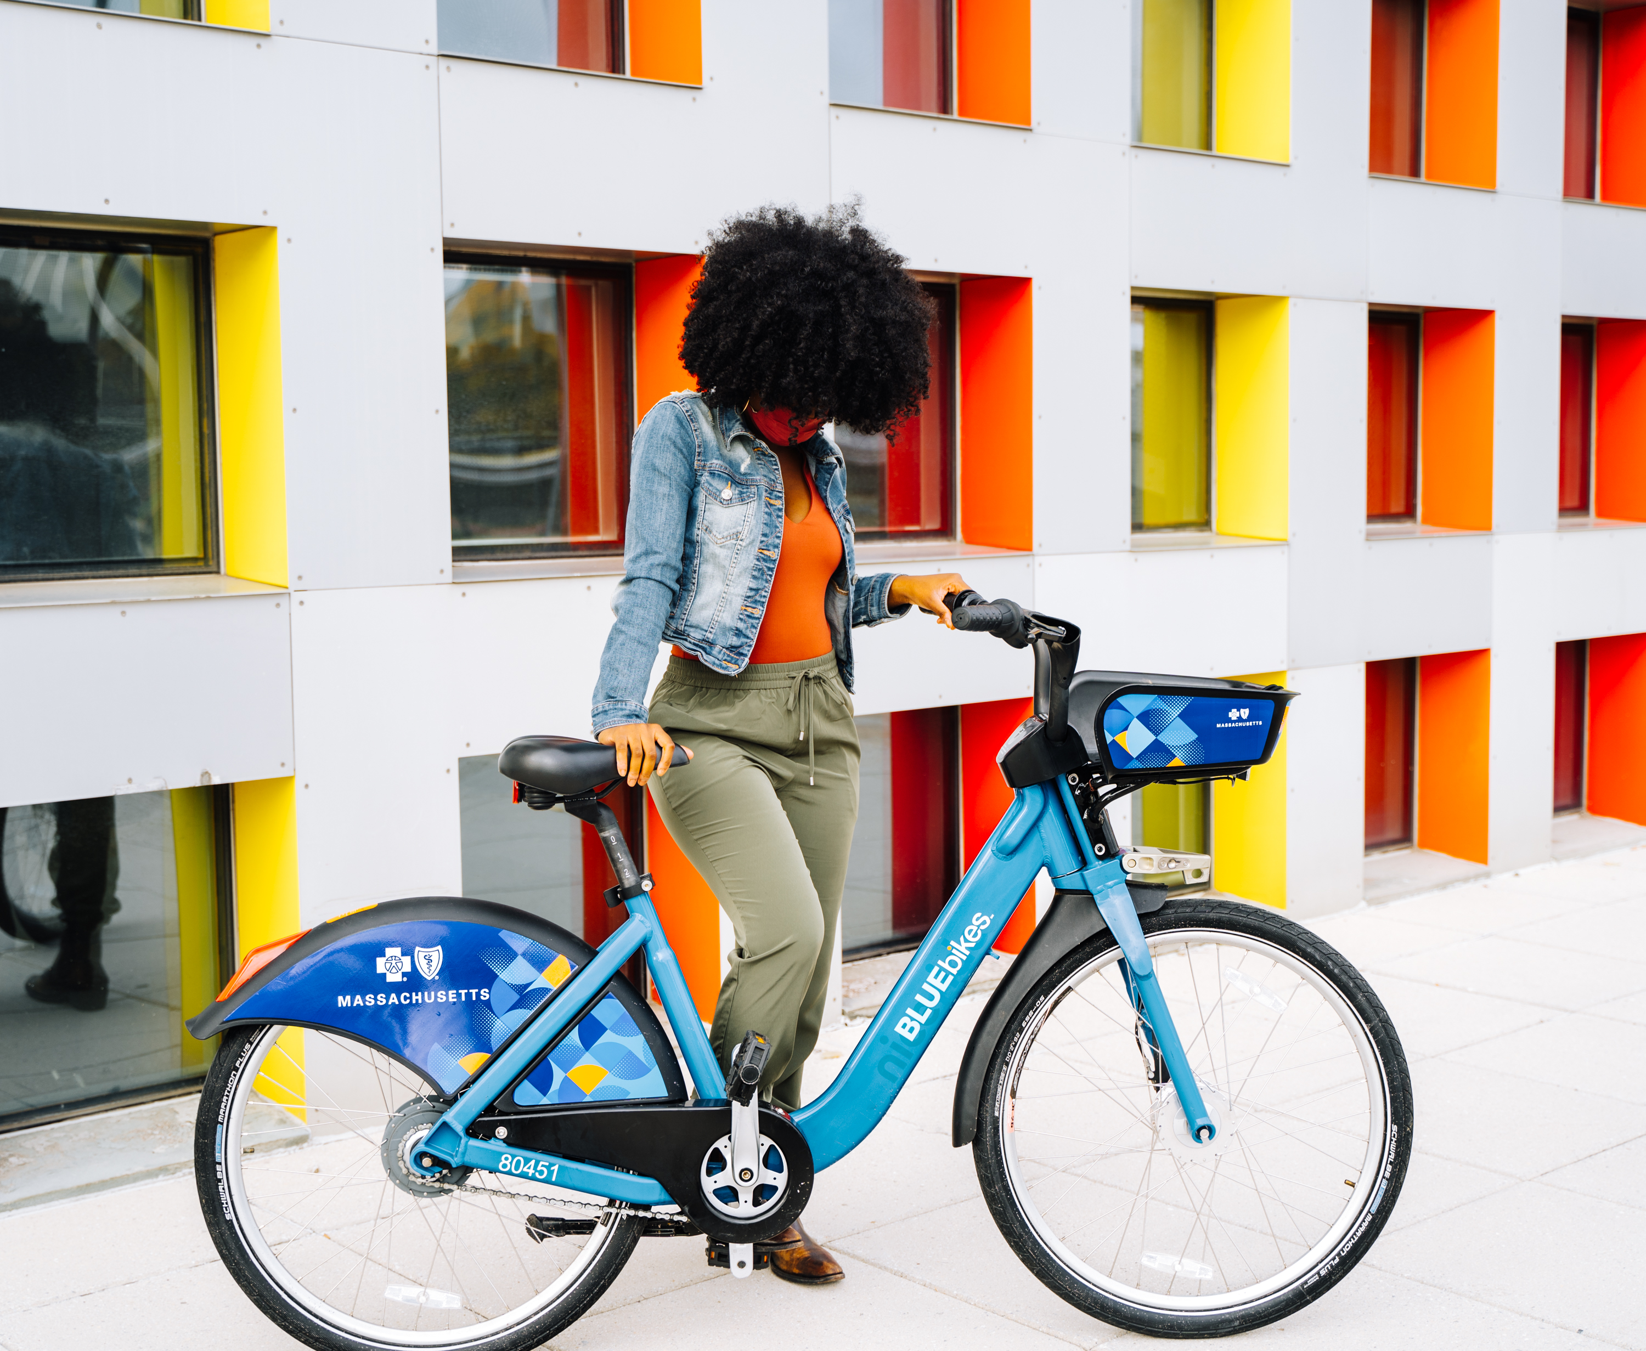
Goals

Slide 6
Goals
Convert their current customer and new customer to subscribe as monthly or annual member
Optimize the amount of bike in the station since some station don’t have many user while the other is crowded

Slide 7
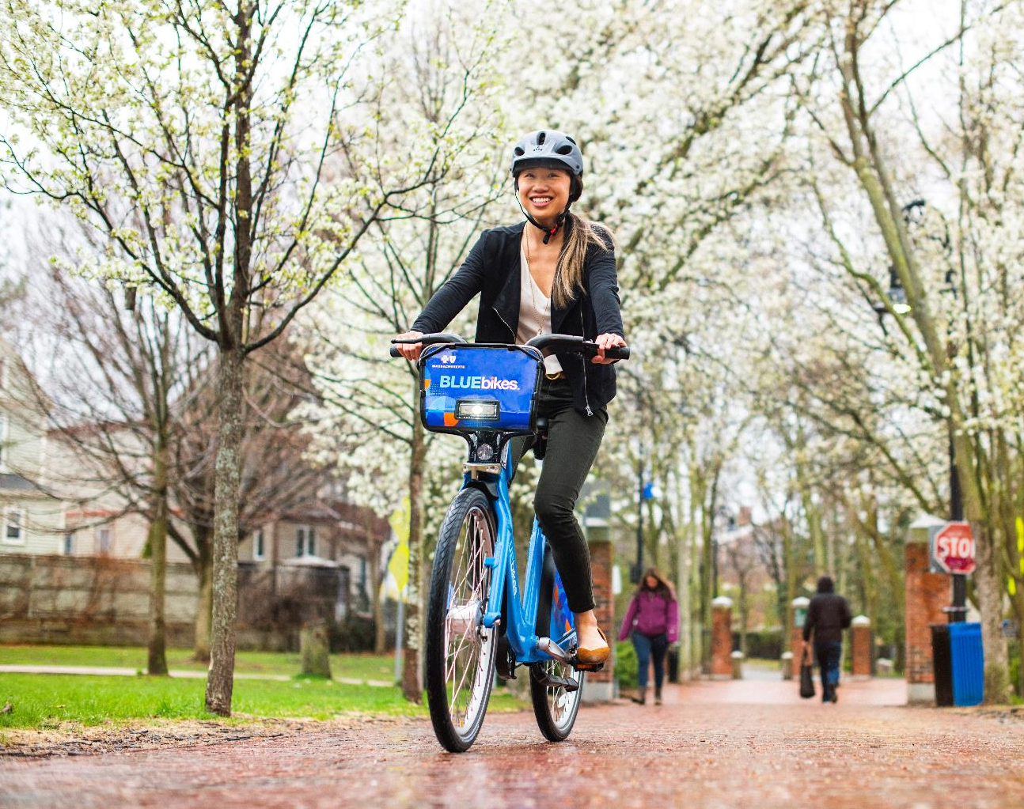
Analysis & Insight

Slide 8
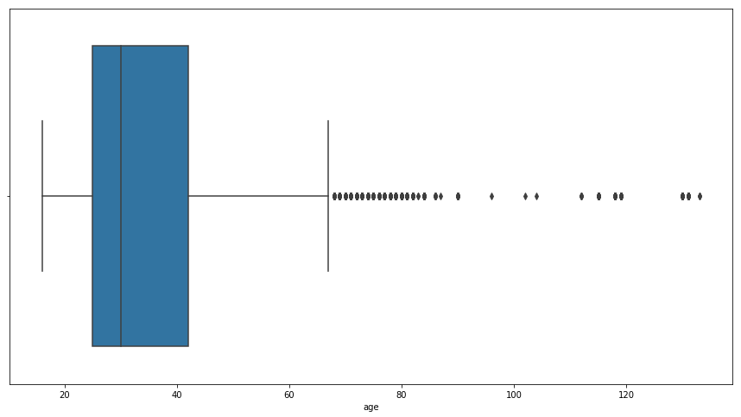
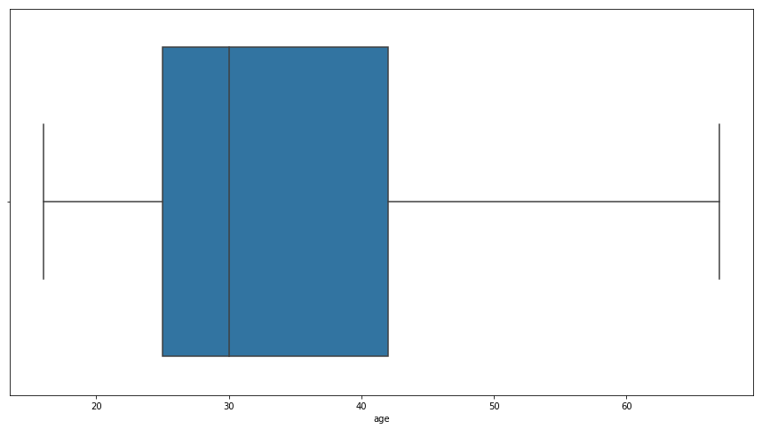
Based on Age
Removing outliers
Before
After
There is a user at the age above 100 which is very unlikely
Remove user at the age above 67:
It has a high risk of injuries, resulting a high trip duration and low trip distance which is not the case for the majority of customer (customer at the age below 67)
Might be an error

Slide 9
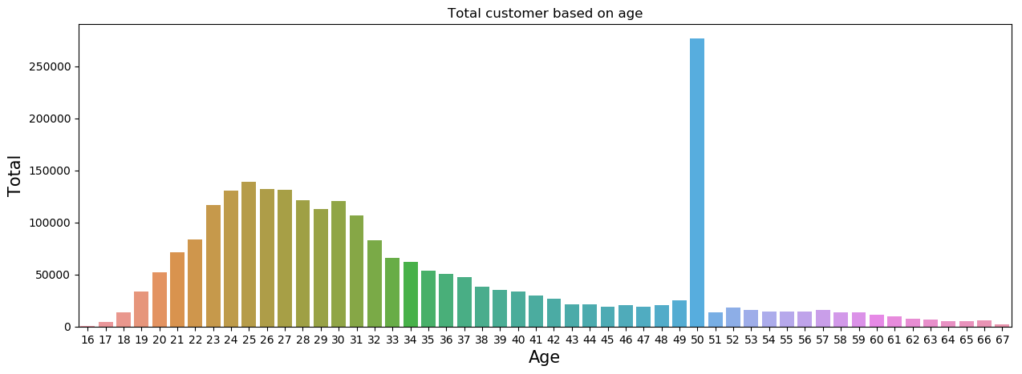
Based on Age
Average user age is around 21 – 33
There is an anomaly in precisely at the age of 50:
Hypothesis : There might be a default input on age = 50
Suggestion : Make year birth input mandatory

Slide 10
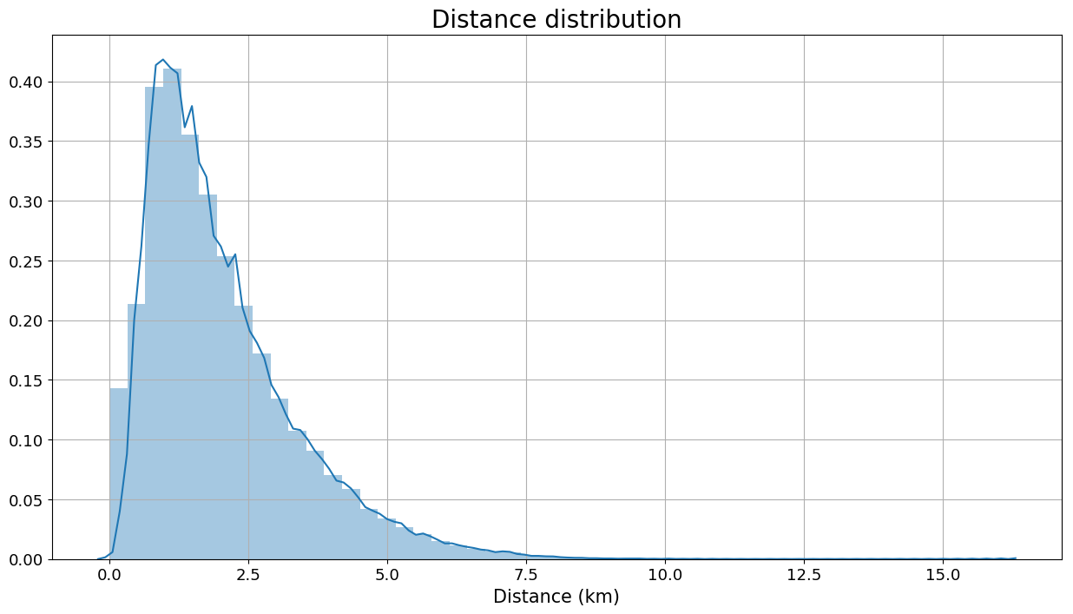
Distance
Average distance traveled is around 1 km
User that travel long distance (around more than 7km) might be a cycling enthusiast

Slide 11
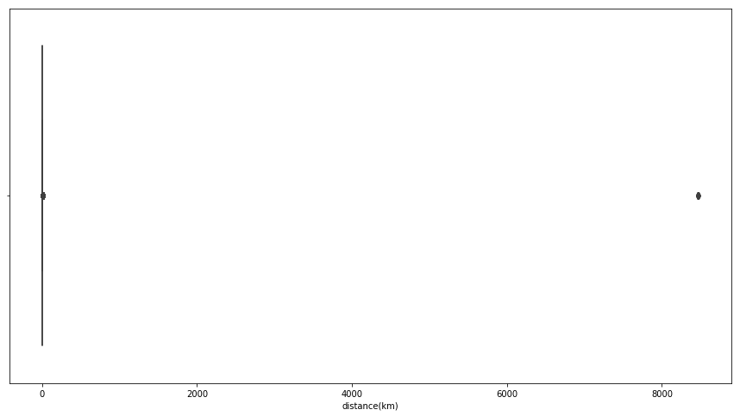
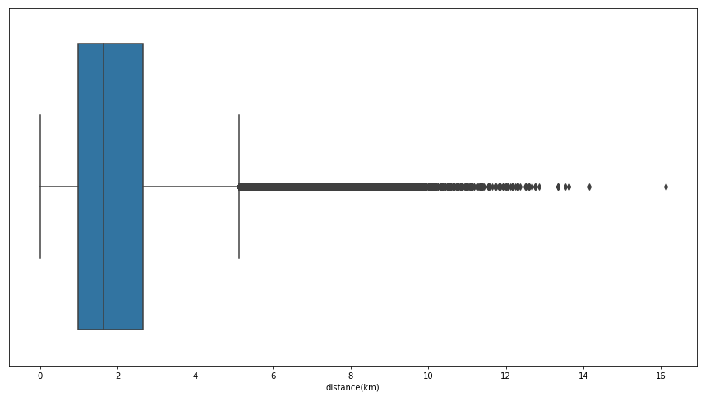
Distance
Removing distance > 100
Before
After
Remove distance more than 100 km because its almost impossible to travel such distance with a bike
Decide not to remove the rest of outliers because it’s possible that user that traveled long distance are bike are cycling enthusiast
Can be a consideration for new product for that target market

Slide 12
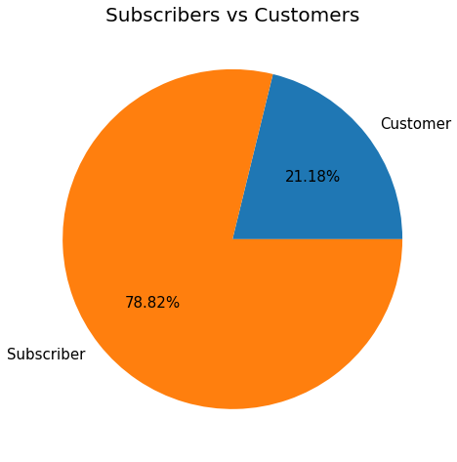
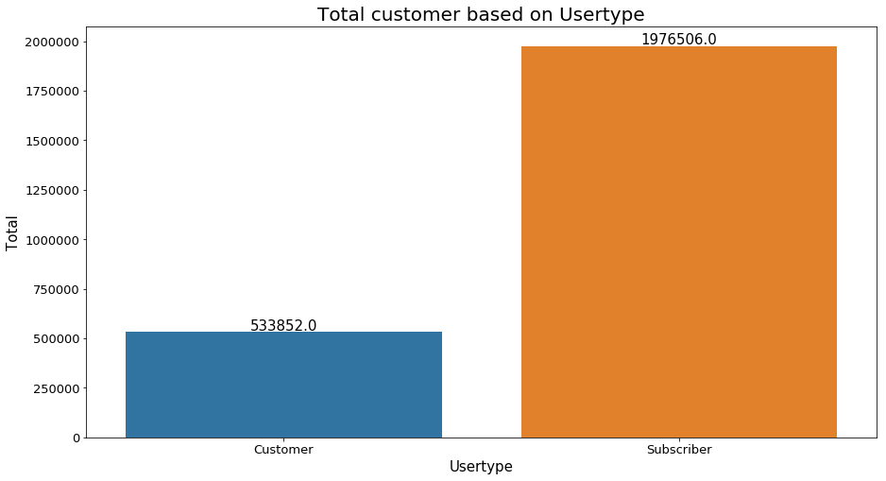
Based on User type
Around ¼ User are Subscriber
Total Customer is 533.852 while total Subscriber is 1.976.506

Slide 13
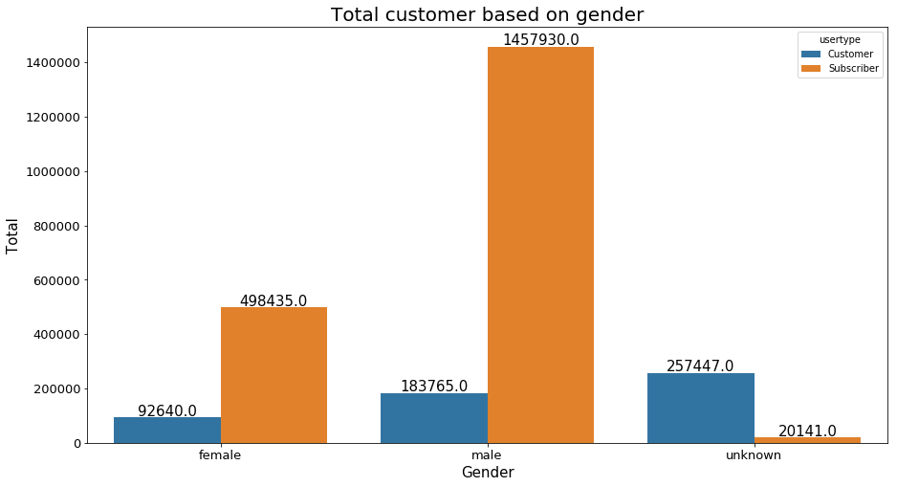
Based on Gender
Male is the dominant user
User with unknown gender is mostly customer

Slide 14
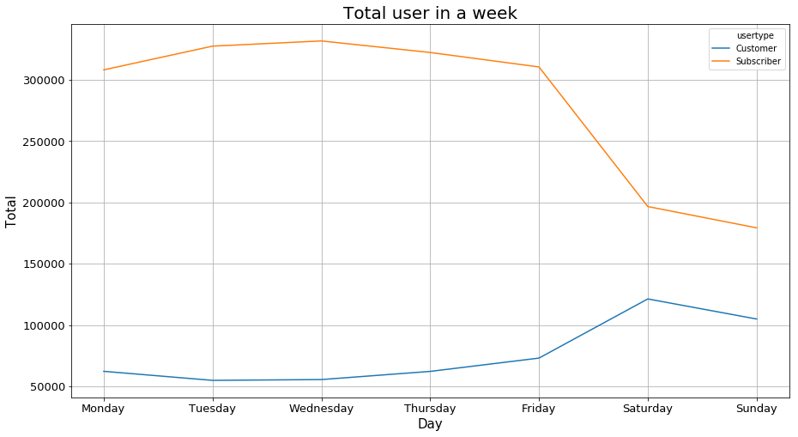
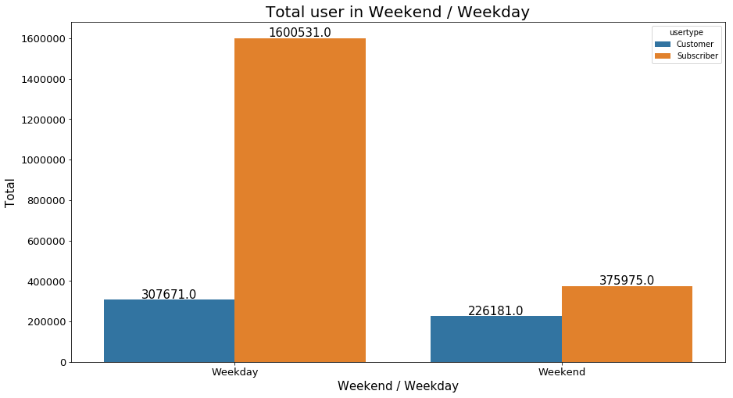
Based on Time : Week
Total user per day on weekday: 381.642
Total user per day on weekend: 301.078
For subscriber, they often use the service usually in weekday but we can see a decline in weekend
Customer on the other hand, they're most often use the service in weekend
On weekend, user per day decline around 80,000 users
However, the composition on weekend for subscriber and customer become very close relatively from weekday
Most subscriber use the bike to go to work, while most customer use the bike as a leisure

Slide 15
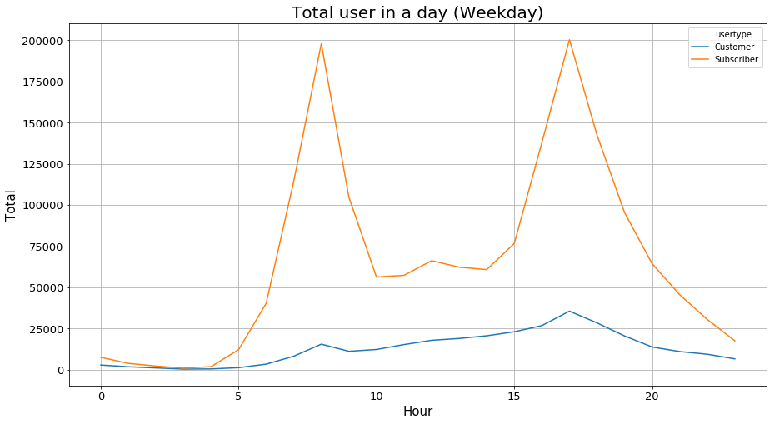
Based on Time: Day
In weekday, many subscriber use the service to go to work
Rush hour starts around 6-8 am and 17 - 18 pm
Customer remain stable almost unaffected by hour
Because customer is relatively unaffected by hour, there is a chance that people that use it is not for job related unlike subscriber which has a pattern, its probable that they're mostly tourist.

Slide 16
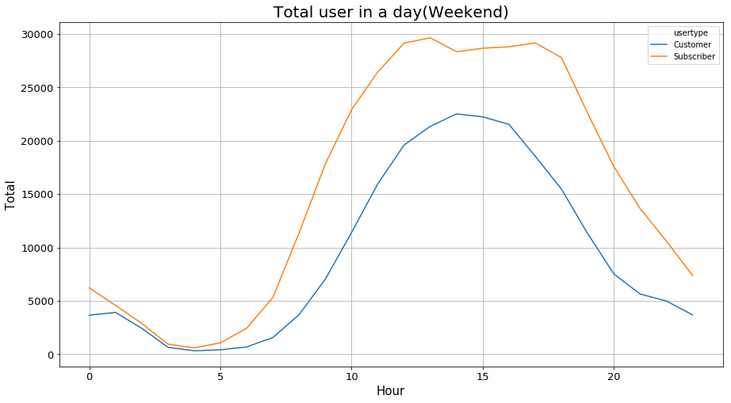
Based on Time: Day
The user pattern between subscriber and customer is similar
There is no pattern like rush hour in weekday
Users mostly ride at 10 am to 18 pm
Most user use it for leisure

Slide 17
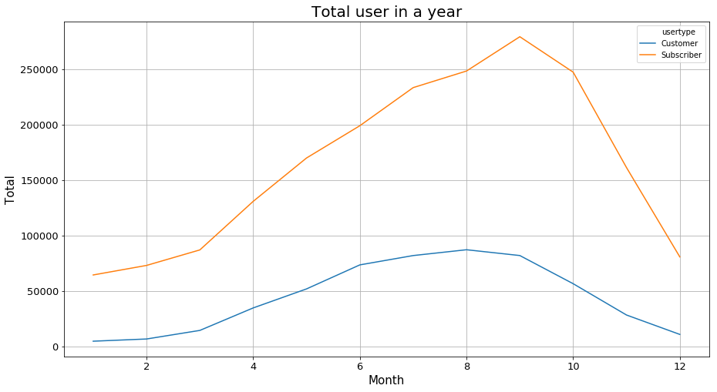
Based on Time: Day
The number of rides per month shows a noticeable rise and decline in a year
The peak occurs in September and the minimum occurs near January
This is likely related to the seasonal weather pattern where summer is the most popular time to ride while in winter less people are likely to ride

Slide 18
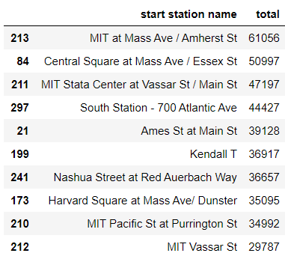
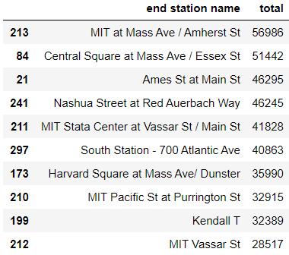
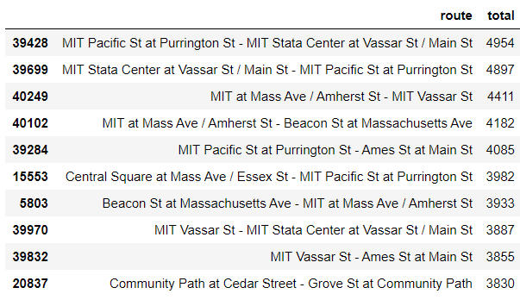
By Station
Top 10 Start Station
Top 10 End Station
Top 10 Route
Most crowded station is located around MIT
These station is located near MIT Campus and not far from Commercial Area (Downtown)

Slide 19
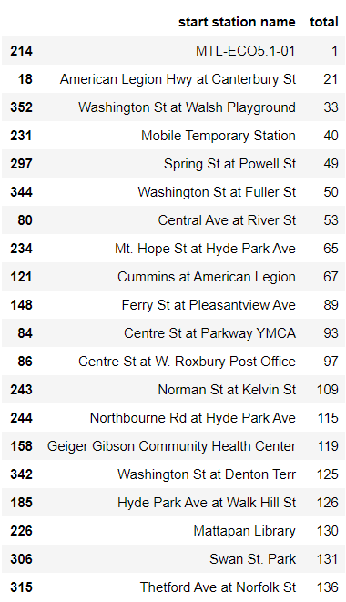
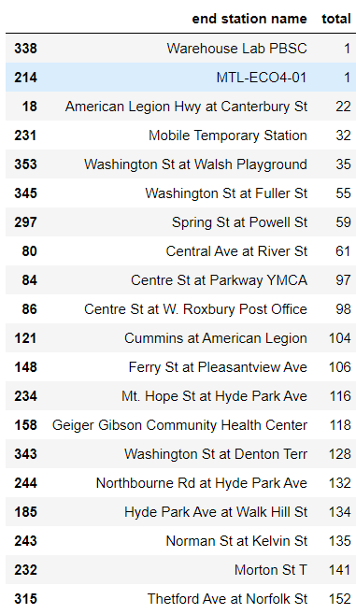
By Station
Bottom 20 Start Station
Bottom 20 End Station
It’s likely that the station with only 1 user in a year is only a temporary or test station

Slide 20
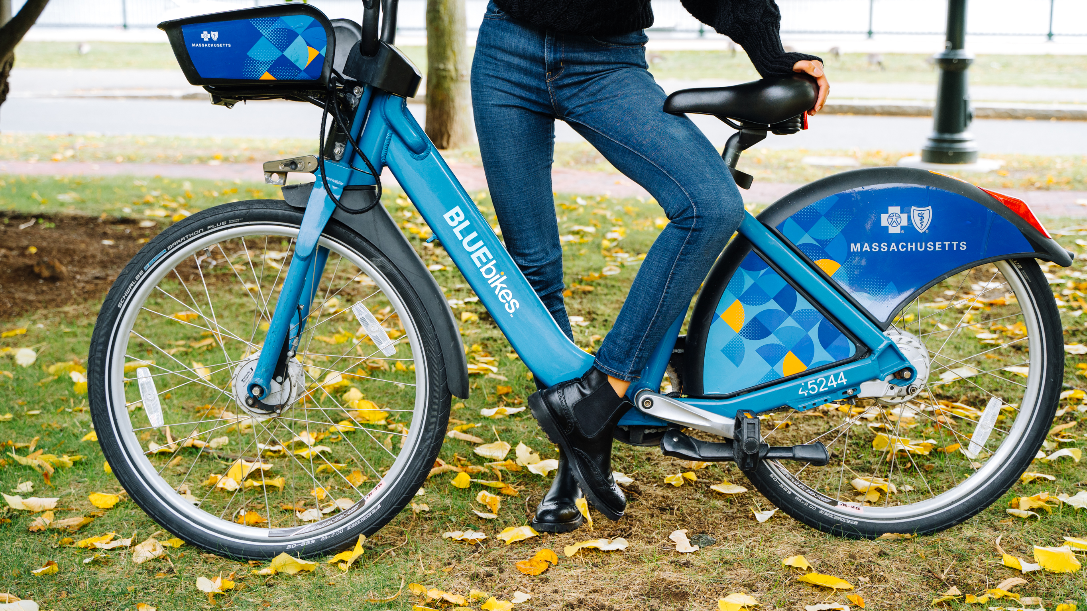
Conclusion & Recommendation

Slide 21
Conclusion & Recommendation
Most of the user age is around 23-32, In addition, because the location is near MIT Campus, it’s expected that there will be many student use this service
There should be a student discount which we can collab with the Campus so many students can use as a transportation to Campus
Recommendation
Since its kind of waste to convert a tourist into subscriber that stay for less than 30 days. We focus on how convert the people who lives there that uses the bike on weekend
Create a monthly or annual pass just for weekend to convert the remaining customer that only want to use the bike for leisure
Recommendation
There is a decline and rise based on the annual season, because there's a significant drop during the winter
Recommendation
Create a winter discount for subscriber to increase the number of subscriber during winter season
Ensuring that no station has empty slots is one of the important issue, which means there should always be a bike in that station
Stations that have less than 100 user in a year should consider to relocate in more crowded area
Station that are less crowded should transfer some of its bike to station that are crowded
Recommendation

Slide 22
Challenge & Limitation
Challenge to determine station based on geographical area such as Campus Area, Commercial area, Residential area to predict the flow of bike for more efficient bike supply

